Slide 1
CRISP-DM Methodology
Y.LAKSHMI PRASAD
08978784848

Slide 2
Objectives
Understanding CRISP-DM Methodology
Model Building Process
Model evaluation Process
How to choose the correct model
Occam’s Razor
Over-fitting
Regularization
Bias-Variance Trade-off
Model Complexity

Slide 3
Cross Industry Standard Process - Data Mining
Two of leading tools providers, SPSS and Teradata, convened a managed way to codify Data Mining Process i.e, CRISP-DM, Cross Industry Standard Process for Data Mining.
SAS Institute had its own version called SEMMA (Sample, Explore, Modify, Model, Assess)

Slide 4
What is CRISP-DM?
The process or methodology of CRISP-DM is described in these Six major steps
1. Business Understanding
2. Data Understanding (Data Exploration)
3.Data Preparation (Data Manipulation)
4.Modeling (Model Building)
5.Evaluation (Model Validation)
6. Deployment (Model Deployment)

Slide 5
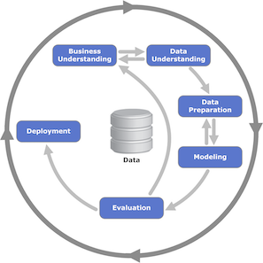
CRISP-DM

Slide 6
1.Business Understanding
1.Business Understanding Focuses on understanding the project objectives and requirements from a business perspective, and then converting this knowledge into a data mining problem definition and a preliminary plan

Slide 7
2.Data Understanding
2.Data Understanding Starts with an initial data collection and proceeds with activities in order to get familiar with the data, to identify data quality problems, to discover first insights into the data, or to detect interesting subsets to form hypotheses for hidden information.

Slide 8
3.Data Preparation
3.Data Preparation The data preparation phase covers all activities to construct the final dataset from the initial raw data.

Slide 9
4.Modeling
Modelling techniques are selected and applied.
Since some techniques like neural nets have specific requirements regarding the form of the data, there can be a loop back here to data prep.

Slide 10
5.Evaluation
5.Evaluation Once one or more models have been built that appear to have high quality based on whichever loss functions have been selected, these need to be tested to ensure they generalize against unseen data and that all key business issues have been sufficiently considered. The end result is the selection of the champion model(s).

Slide 11
6.Deployment
6.Deployment Generally this will mean deploying a code representation of the model into an operating system to score or categorize new unseen data as it arises and to create a mechanism for the use of that new information in the solution of the original business problem. Importantly, the code representation must also include all the data prep steps leading up to modeling so that the model will treat new raw data in the same manner as during model development.
You may well observe that there is nothing special here and that’s largely true. From today’s data science perspective this seems like common sense. This is exactly the point. The common process is so logical that it has become embedded into all our education, training, and practice.

Slide 12
TDSP (Team Data Science Process)
TDSP is a collection of process flow, tools and utilities to assist not only you but your team provide the Data Science component of your Enterprise Data Platform.

Slide 13
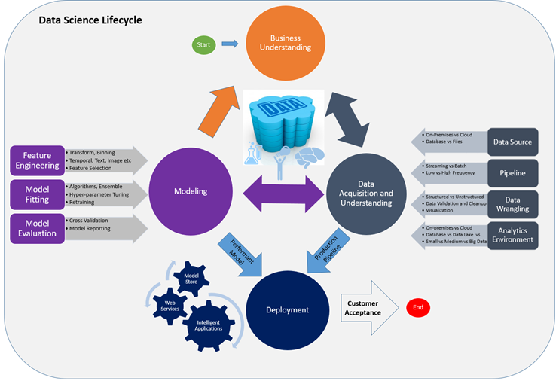
TDSP

Slide 14
From Data to Decisions…
Insights
(Data Exploration)
Features
(Data Preparation)
Domain
Knowledge
Data
Models
(Model Building)
Feedback
Predictions
Decision
Business Objectives
Business Constraints

Slide 15

Approving Loans
Insights
Features
Accidental defaults
Intentional defaults
Domain
Knowledge
Default prediction in 60 days
Not Real-Time Decisions
6 Mn Delayed Feedback
Wrong Decision very costly!
Data
Models
Payment behavior
Pays ahead of time
Pays on time
Pays with some delay
Defaults on payments
Filed Bankruptcy
Probability of default given past payment behavior
Feedback
Predictions
Credit Limit
Interest Rate
Approve?
Decision
Minimize Risk
Maximize Profit

Slide 16
Supervised Learning
Supervised learning is the concept of function approximation, where basically we train an algorithm and in the end of the process we pick the function that best describes the input data the one that for a given X makes the best estimation of y (X→y).
Supervised learning is the Machine learning task of finding a function from a labelled data.

Slide 17
Supervised Learning
Supervised learning algorithms try to model relationships and dependencies between the target prediction output and the input features such that we can predict the output values for new data based on those relationships which it learned from the previous data sets.

Slide 18
Supervised Learning
Labelled data is a dataset which has independent variables and a dependent variable.
If you have a Labelled class column, the analysis is supervised Learning.
Most of the time we are not able to figure out the true function that always make the correct predictions and other reason is that the algorithm rely upon an assumption made by humans about how the computer should learn and this assumptions introduce a bias.

Slide 19

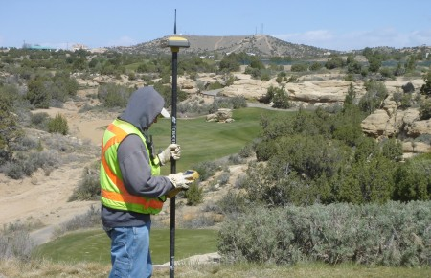
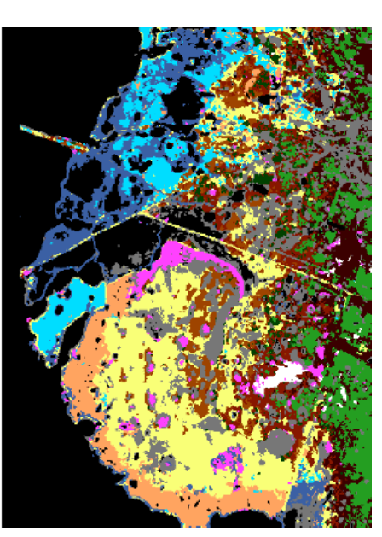
Supervised Learning Process!
Collect Raw (Input) Data
Collect (Output) Ground Truth!
Engineer “Predictive” features
“Train” an ML “Model”
Choose Model type & complexity
Deploy Model. Make Predictions on Unlabeled data
Evaluate, Iterate, Improve Model

Slide 20
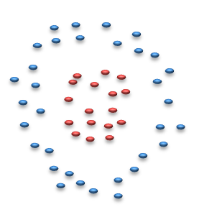
Two types of Classifiers
Descriptive/Generative Classifiers
Learn class DENSITY Functions
NaiveBayes
Discriminative Classifiers
Learn class SEPARATORS
Decision Trees
Support Vector Machines
Neural Networks

Slide 21
Good modeling technique?
A good modeling technique should posses some or all of these properties.
1. Accuracy
2. Speed/ Fast
3. Versatile/ Robust
4. Scalability
5. Interpretability/ Explainability
6. Generalized
7. Deterministic
8. Regularization/ Complexity Knob

Slide 22
Expectations from Model
1. Accuracy = Percent (%) of testing set examples correctly classified by the classifier.
2. Speed: The computation costs involved in generating and using the model should be as minimum as possible.
3. Versatile: Ability of the model to make correct predictions given noisy data or data with missing values.
4. Scalability: Ability to construct the model efficiently given large amount of data.

Slide 23
Expectations from Model
5. Interpretability/ Explain-ability: Level of understanding and insight that is provided by the model
6. Generalized: It should be able to give the same amount of accuracy on validation set.
7. Deterministic: I expect my model to give me the same result every time I run it.
8. Regularization: I expect my model complexity should be controlled by me, So that I can prevent my model from over-fitting.

Slide 24
Introduction to Model Selection
You may have come across situations where a model performs well on training data but not on the test data. Also, you would have faced confusion about which model to use to a given problem.
Given a problem that requires classification, how would you decide about the best one to go with?

Slide 25
Introduction to Model Selection
The central issue in machine learning is “how do we extrapolate learning from a finite amount of available data to all possible inputs ‘of the same kind’?”.
Training data is always finite, yet the model is supposed to learn everything about the task at hand from it and perform well on unseen data.

Slide 26
Introduction to Model Selection
How do you ensure, and be confident, that the model is as good as it seems on the training data and deploy it to make predictions on real, unseen data?
Often, it is mistaken that if a model performs well on the training data, it will produce good results on test data as well. Very often, that is not the case.

Slide 27
Central Issue in Machine Learning
The central issue in machine learning can be said to be the study of:
A) How to choose models so as to achieve the highest level of accuracy.
B) How to learn from finite available data so as to explain it as best as possible.
C) How to extrapolate learning from a finite amount of data to explain or predict all possible inputs of the same kind.
D) None of these.

Slide 28
Feedback
Machine learning does not simply involve building models to fit the available data. The real challenge is to learn patterns which can be used to explain the behaviour of similar unseen data.

Slide 29
Occam's razor
Occam's razor is perhaps the most important thumb rule in machine learning, and incredibly 'simple' at the same time.
When in dilemma, choose the simpler model.
The question then is 'how do we define simplicity?'.

Slide 30
Occam's Razor
Occam's razor (or Ockham's razor) is a principle from philosophy.
Suppose there exist two explanations for an occurrence, In this case the one that requires the least speculation is usually better.
Another way of saying it is that the more assumptions you have to make, the more unlikely an explanation.

Slide 31
Occam's Razor
Occam's razor also comes up in medicine. When there are many explanations for symptoms, the simplest diagnosis is the one to test first. If a child has a runny nose, it probably has the common cold rather than a rare birth defect

Slide 32
Occam's Razor
Occam’s razor is a fundamental principle which suggests that:
A) A model should be simplified as much as possible
B) A model should be as simple as possible, but robust.
C) Both of them
D) None of them

Slide 33
Feedback :
Feedback :Occam’s razor does not say that a model should be unjustly simplified till no further simplification is possible.
It says that when faced with a trade-off between a complex and a simple model, with all other things being roughly equal, you are better off choosing the simpler one.

Slide 34
Regression Models
Choose the simplest regression model among the following (all lowercase alphabets are features):
A) Y = 3x + 0.005z + w
B) Y = x + 58z + log(w)
C) Y = x + 3w
D) Y = 2x + exp(w)

Slide 35
Model and Learning Algorithm
Let us Understand the process of using training data, learning from it and then building a model to describe a system which performs a task at hand, like classification or regression.
The key objectives here are to understand:
1. The meaning of model, learning algorithm, system and hypothesis class.
2. The difference between a learning algorithm and a model.
3. The meaning of ‘class of models’.

Slide 36
Learning algorithm
Basic property of a learning algorithm - that it can only produce models of a certain kind within its boundaries.
This means that an algorithm designed to produce linear class of models, like linear / logistic regression, will never be able to produce a decision tree or a neural network.
The class of model becomes critical because a wrong class will yield a sub-optimal model.

Slide 37
Model and Learning Algorithm
Choose the correct statement:
A) The model is told what needs to be done, it figures out how it needs to be done and returns a learning algorithm
B) The learning algorithm is told what needs to be done, it figures out how it needs to be done and returns a model
C) The learning algorithm does not concern itself with what needs to be done

Slide 38
4 points about using a simpler model
1. A simpler model is usually more generic than a complex model. This becomes important because generic models are bound to perform better on unseen datasets.
2. A simpler model requires less training data points. This becomes extremely important because in many cases one has to work with limited data points.
3. A simple model is more robust and does not change significantly if the training data points undergo small changes.
4. A simple model may make more errors in the training phase but it is bound to outperform complex models when it sees new data. This happens because of over-fitting.

Slide 39
Over-fitting – Test our Understanding
Let us take a situation where two people are preparing for a competitive exam:
The most extreme case of over-fitting is:
A) The second person is absolutely clear and confident about the underlying principles of the subjects
B) The first person has mugged up all the possible questions using numerous text-books and preparation material
C) The first person has used numerous practice questions to develop his understanding of the subjects and the underlying principles pretty well

Slide 40
Disadvantages of Complexity
The disadvantages the first person is likely to face because of a complex model are (mark all that apply):
A) He’ll need more training data to ‘learn’
B) Despite the training, he may as well not learn and perform poorly in the real world
C) He is likely to perform poorly on the training data compared to the second fellow.

Slide 41
Over-fitting
Over-fitting is a phenomenon where a model becomes too specific to the data it is trained on and fails to generalise to other unseen data points in the larger domain.
A model that has become too specific to a training dataset has actually ‘learnt’ not just the hidden patterns in the data but also the noise and the inconsistencies in the data.
In a typical case of over-fitting, the model performs very well on the training data but fails miserably on the test data.

Slide 42
Over-fitting –Test our Understanding
The possibility of over-fitting exists primarily because:
A) All models have a tendency to memorize the data rather than learning from it
B) Models are usually provided with a large amount of training data
C) Models are trained on a set of training data but their efficacy is determined by the ability to perform well on unseen (test) data
D) Models have a tendency to become complex while being trained unless we deliberately try to make them simpler

Slide 43
Over-fitting –Test our Understanding
Feedback :It is possible to memorize the training data while failing to truly learn the underlying trends and patterns. On unseen data (read tricky but unseen exam questions), memorizing is bound to fail.

Slide 44
Over-fitting in Linear Regression
In linear regression, which of the following are clear signs of over-fitting?
A) The R-squared value on is 0.80 on both training and testing data
B) The R-squared value on training data is 0.80 and 0.90 on train and test data respectively
C) The R-squared value on training data is 0.90 and 0.30 on train and test data respectively
D) None of the above

Slide 45
Feedback
Feedback :In over-fitting, the model fits the training data very well since it has somehow memorised it.

Slide 46
Bias-Variance Trade-off
We know the pros and cons of simple and complex models. On one hand, simplicity is generalizable and robust. But, Some problems are inherently complex in nature.
There is a trade-off between the two, which is known as the bias-variance trade-off in machine learning.

Slide 47
Variance
If a model memorizes the entire training dataset, If you change the dataset a little, this model will need to change drastically. The model is, therefore, unstable and sensitive to changes in training data, and this is called high variance.
The ‘variance’ of a model is the variance in its output on some test data with respect to the changes in the training data.
In other words, variance here refers to the degree of changes in the model itself with respect to changes in training data.

Slide 48
Bias
Bias quantifies how accurate the model is likely to be on future (test) data. Extremely simple models are likely to fail in predicting complex real world phenomena. Simplicity has its own disadvantages.
Imagine solving digital image processing problems using simple linear regression when much more complex models like neural networks are typically successful in these problems. We say that the linear model has a high bias since it is way too simple to be able to learn the complexity involved in the task.

Slide 49
Bias-Variance Trade-off
In an ideal case, we want to reduce both the bias and the variance, because the expected total error of a model is the sum of the errors in bias and the variance.
Although, in practice, we often cannot have a low bias and low variance model.
As the model complexity goes up, the bias reduces while the variance increases, hence the trade-off.

Slide 50
Model Variance - Regression
Mr. Prasad builds two linear regression models to solve the Regression problem.
-- model (1) has 3 features and model (2) has 11 features.
Which model is likely to undergo a larger change when a new training dataset is used?
A) Model 1
B) Model 2

Slide 51
Model Variance - Regression
Feedback :Model 2 can change its 11 coefficients (and the constant term) to fit the new training data.

Slide 52
Bias and Variance
An artificially generated dataset was used to generate data, Three regression models have been created to fit the data - linear, a degree-3 polynomial and a higher degree polynomial which passes through all the training points.
The correct order of bias in the three models is:
A) Straight line > Degree-3 > Polynomial
B) Straight line > Polynomial > Degree-3
C) Polynomial > Degree-3 > Straight line
D Polynomial > Straight line > Degree-3

Slide 53
Bias and Variance
Feedback :The bias is high when the model is too simple.

Slide 54
Variance – Test our Understanding
The variance in the higher degree polynomial is said to be higher than the other two models because:
A) The variance in the y-values of the polynomial is clearly higher, as shown in the figure
B) The model will change drastically from its current state when plotted on unseen test data
C) The model will change drastically from its current state if the current training data is altered
D) The y-values of the model will change drastically from the current y-values when tested on unseen data

Slide 55
Variance – Test our Understanding
Feedback :Variance refers to changes in the model as a whole when trained on a different dataset. Since the polynomial is trying to overfit the data, it will change drastically with respect to it.

Slide 56
Regularization
Regularization is the process of deliberately simplifying models to achieve the correct balance between keeping the model simple and yet not too naive. Recall that there are a few objective ways of measuring simplicity - choice of simpler functions, lesser number of model parameters, using lower degree polynomials, etc.

Slide 57
Regularization - Test
Regularization is typically performed while:
A) The model is being tested on unseen data
B) The learning algorithm uses the training data to produce a model
C) The learning algorithm uses the test data to produce a model
D) The model uses the training data to produce a model

Slide 58
Regularization - Test
Feedback :The learning algorithm performs the process while it is learning from training data.

Slide 59
Which model to apply?
We learnt various machine learning models such as logistic regression, KNN, decision trees, NaiveBayes.
The question is, how do you choose which model(s) to apply to a given business problem?

Slide 60
Which model to apply?
One option is to apply all the models and compare their results; but is it always feasible to apply all the models? Sometimes, you won’t have enough time to try all the available options.
More importantly, it is helpful to be able to identify some guiding principles behind the choice of models, rather than using a hit-and-trial approach.

Slide 61
Logistic Regression - Test
Which of the following is correct about logistic regression?
A) A logistic regression model calculates the class probabilities of all the classes of the outcome variable, while predicting a test case.
B) The decision boundary of an LR model is a sigmoid curve line.
C) The decision boundary of an LR model is a straight line.
D) A logistic regression model predicts the class of the test case without creating any probabilities.

Slide 62
Logistic Regression - Test
Feedback :The separator, between different classes of a logistic regression model, is always a linear line that is determined by the cut-off chosen after building the model.
Feedback :Logistic regression calculates the class probabilities of all the classes present in the outcome variable, using the logistic function. The final class is predicted by providing a cut-off value.
Feedback :The logistic regression model separates two different classes using a line linearly. The sigmoid curve is only used to calculate class probabilities. The final classes are predicted based on the cut-off chosen after building the model.

Slide 63
Advantages of Logistic regression
Logistic regression
It is convenient for generating probability scores.
Efficient implementation is available across different tools.
The issue of multicollinearity can be countered with regularisation.
It has widespread industry use.

Slide 64
Cons of Logistic regression
Cons of Logistic regression
It does not perform well when the features space is too large.
It does not perform well when there are a lot of categorical variables in the data.
The nonlinear features have to be transformed to linear features in order to efficiently use them for a logistic model.
It relies on entire data i.e. if there is even a small change in the data, the logistic model can change significantly.

Slide 65
Advantages of Decision trees
Decision trees
Intuitive decision rules make it easy to interpret.
Trees handle nonlinear features well.
The variable interaction is taken into account.

Slide 66
Cons of Decision trees
Cons of Decision trees
Trees are highly biased towards the training set and overfit it more often than not.
There is no meaningful probability score as the output.

Slide 67
Pros and Cons of Different ML Models- Test
Which of the following algorithms will not perform well when the relationship between the dependent and independent variable in a data set is nonlinear?
A) Logistic regression
B) Support vector machines
C) Decision trees
D) Random forest

Slide 68
Pros and Cons of Different ML Models- Test
Feedback :Since logistic regression separates the different classes of the dependent variable using a line, there should be linear dependence between the dependent and independent variable for it to work well.

Slide 69
Pros and Cons of Different ML Models- Test
Which of these algorithms’ result is easiest to explain to someone who does not possess any knowledge of machine learning?
A) Support vector machines
B) Decision trees
C) Random forest
D) Neural Networks

Slide 70
Pros and Cons of Different ML Models- Test
Feedback :Because of the intuitive nature of decision trees, their results can be easily interpreted and explained.

Slide 71
choice of algorithms:
You could get overwhelmed by the choice of algorithms available for classification. To summarise—
Start with logistic regression. Using a logistic regression model serves two purposes: 1) It acts as a baseline (benchmark) model. 2) It gives you an idea about the important variables.

Slide 72
Choice of algorithms
Then, go for decision trees and compare their performance with the logistic regression model. If there is no significant improvement in their performance, then just use the important variables drawn from the logistic regression model.

Slide 73
CART vs CHAID
What is the main difference between CART and CHAID trees?
A) CART is used for classification, and CHAID is used for regression.
B) CART can create multiway trees (more than two children for a node), and CHAID can only create binary trees (a maximum of two children for a node).
C) CART can only create binary trees (a maximum of two children for a node), and CHAID can create multiway trees (more than two children for a node).

Slide 74
CART vs CHAID
Feedback :CART can only build binary trees, whereas CHAID can build multi-way trees.

Slide 75
CART vs CHAID
Suppose you are asked to build a decision tree model for a classification problem, by your manager. The aim of the organisation is to understand the driver KPIs (Key Performance Indicators), i.e. features that play an important role in the problem at hand. Which type of tree would be more appropriate for this task?
A) CART (Classification and Regression Tree)
B) CHAID (Chi-square Automatic Interaction Detection)

Slide 76
CART vs CHAID
Feedback :CHAID trees are suitable when you need to understand the driver KPIs, instead of predicting the class.

Slide 77
Disadvantages of decision trees:
Trees have a tendency to overfit the training data.
Splitting with multiple linear decision boundaries that are perpendicular to the feature spaceis not always efficient.
It is not possible to predict beyond the range of the response variable in the training data in a regression problem. Suppose you want to predict house prices using a decision tree and the range of the house price (response variable) is $5000 to $35000. While predicting, the output of the decision tree will always be within that range.

Slide 78
Approach towards model building
Which is the more appropriate approach towards model building?
A) Start from a simple model; and only build complex models if the simple ones do not meet the required standards.
B) Start from a complex model because simple ones are always less accurate.

Slide 79
Test- Which Model to use?
Which of these is most appropriate to use as a baseline (benchmark) model?
A) Logistic regression
B) KNN
C) NaiveBayes
D) Decision trees

Slide 80
Test- Which Model to use?
Feedback :Logistic regression is simple to run, with no hyper parameters to tune. It can be used as a benchmark to compare the performance of other models.

Slide 81
Which model to use?- Test
Given a decision tree model on a binary classification task, which among the following is the best way to check whether the tree is over-fitting?
A) Plot the tree, if it has more than 10 leaves, it may be over-fitting.
B) Plot the tree, if it has more than 25 nodes, it may be over-fitting.
C) Look at the number of observations in each node, if any node has lesser than 50 observations, it may be over-fitting.
D) Compare the accuracy of the tree model on the training and validation sets.

Slide 82
Which model to use?- Test
Feedback :If the difference between training and validation accuracy is significant, then you can conclude that the tree has over-fitted the data.

